Slide 1
FINE-TUNING STABLE DIFFUSION FOR STYLE TRANSFER

Slide 2


PROBLEM DEFINITION
The task of fine-tuning stable diffusion for style transfer involves optimizing diffusion methods to effectively imbue target images with desired artistic styles. This entails refining diffusion parameters to ensure stable and faithful style transfer results across various input images and artistic styles.
Style : Clipart
“An Image of a Doctor”

Slide 3
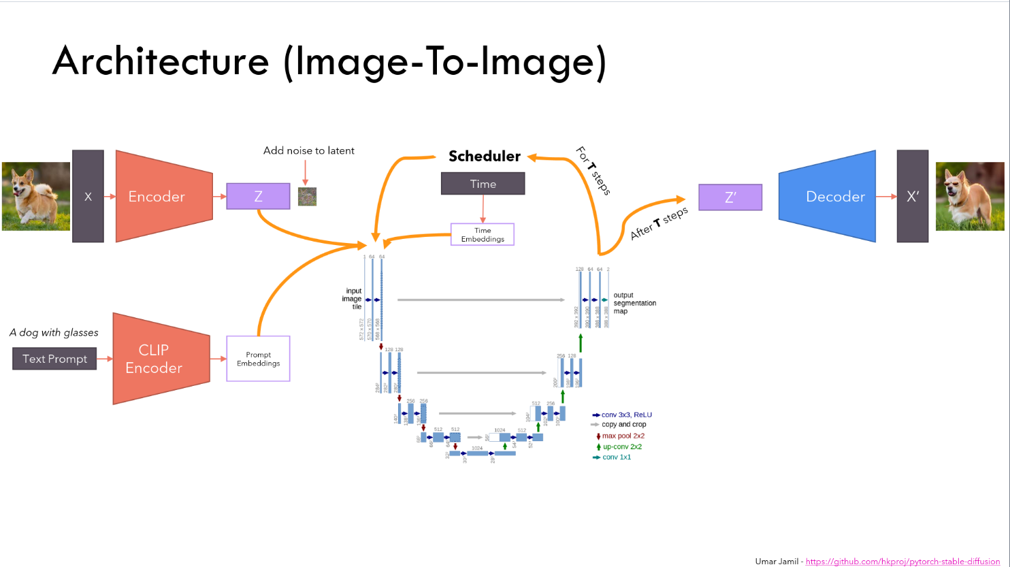


METHODOLOGY
1)LoRA Adapter on CLIP Encoder ,Conditional-Unet and C-VAE
2)Plan to take a few shot approach with style transfer using only 8 images of the paradigm under consideration in that particular style
An image in the style of ##
:LoRA Adapters
:Train
:Frozen

Slide 4
RESULTS FOR
IMAGE GENERATION and
STYLE TRANSFER BY CHANGING THE TRAINABLE LAYERS

Slide 5
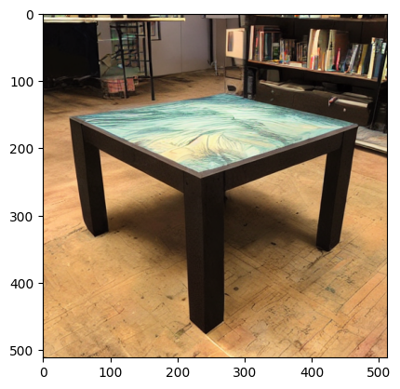
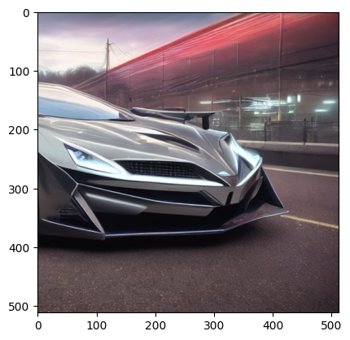

IMAGES USED FOR THE ANALYSIS OF STYLE TRANSFER:

Slide 6
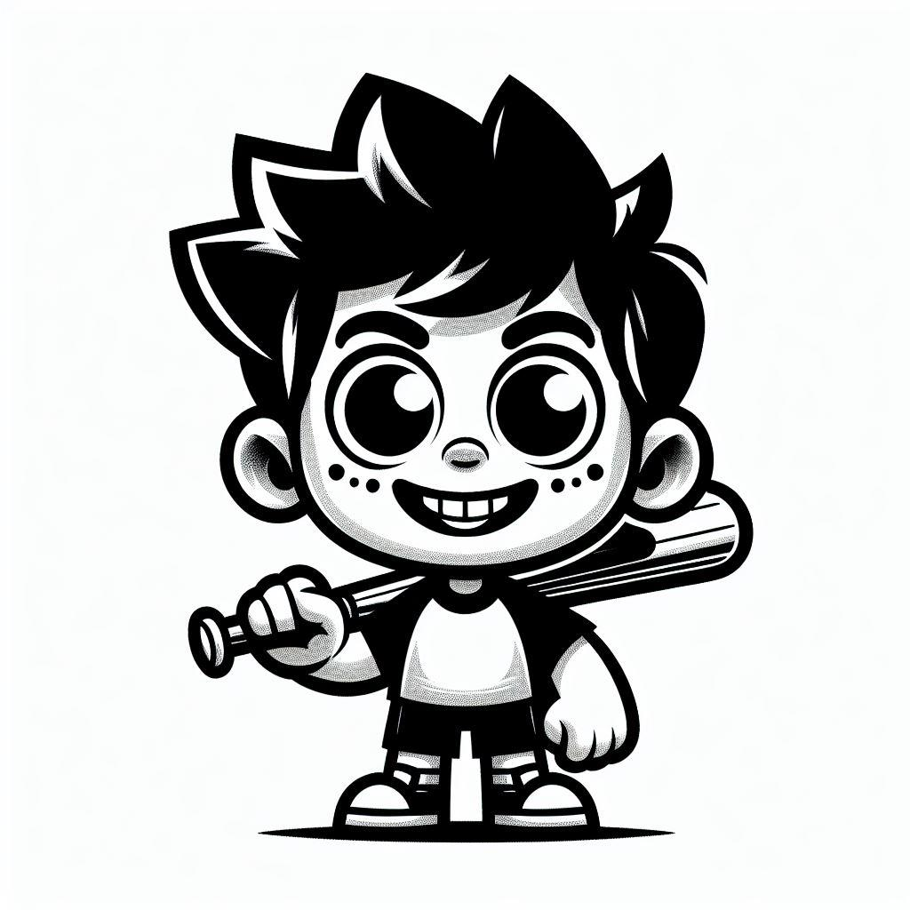


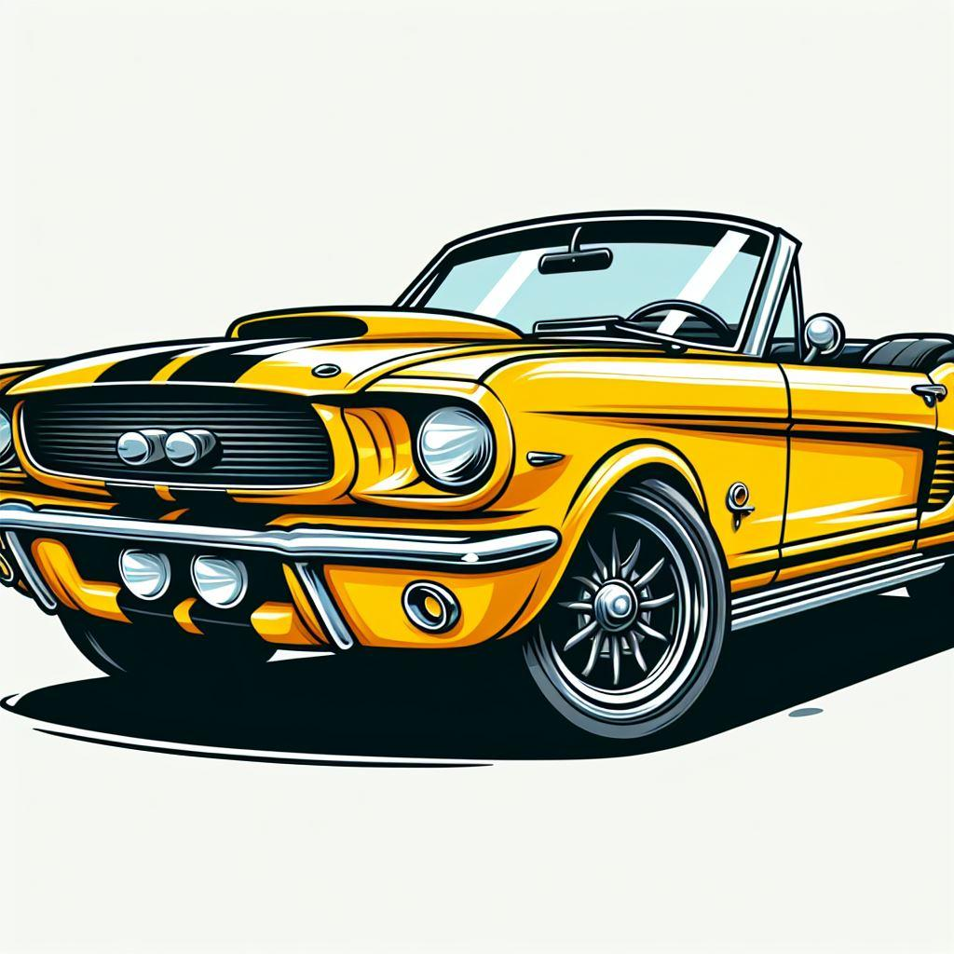
STYLE: CLIPART

Slide 7
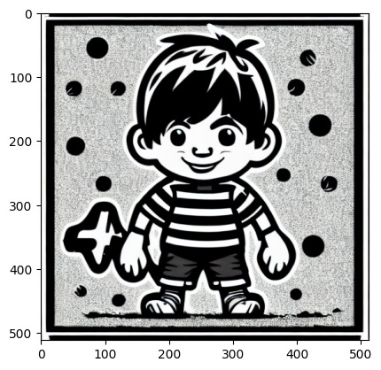
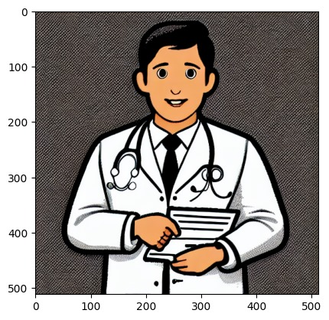
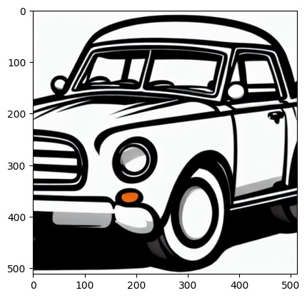
WITH FT. ALL (image generation)

Slide 8
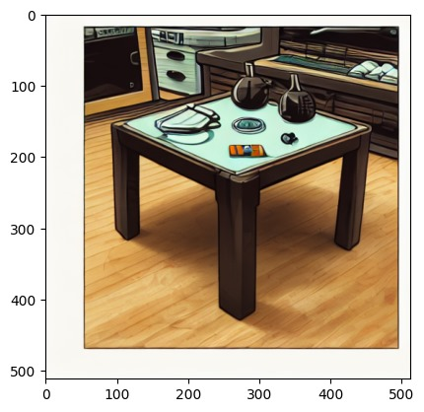
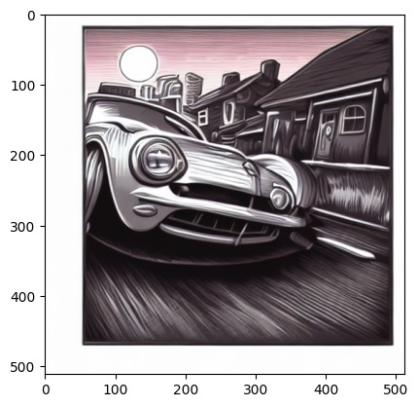
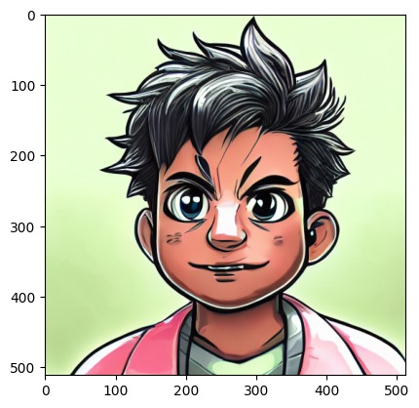
WITH FT. ALL
(style transfer)

Slide 9
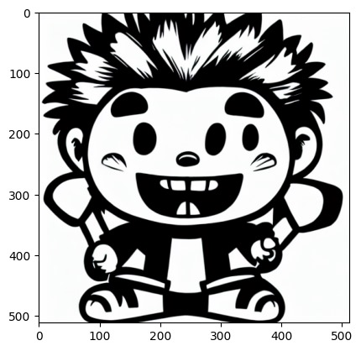
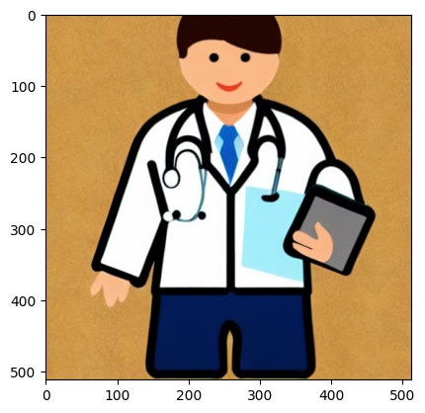
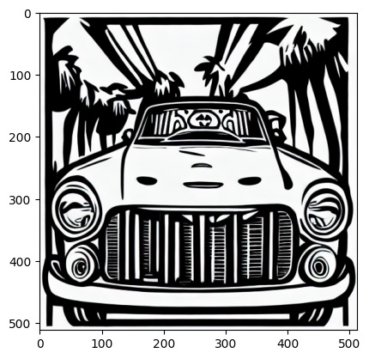
WITHOUT FT. VAE
(image generation)

Slide 10
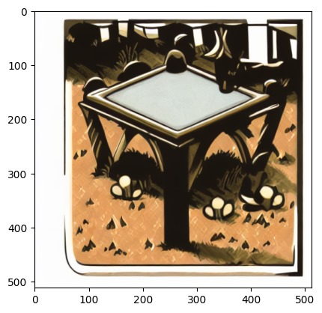
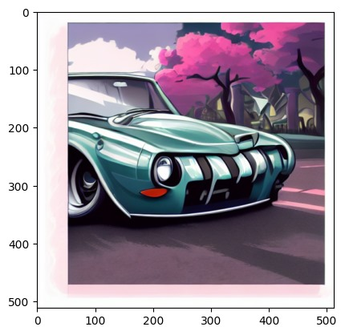
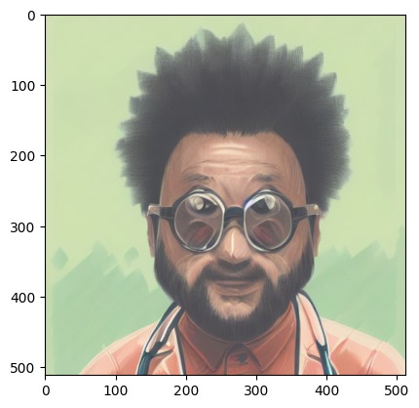
WITHOUT FT. VAE
(style transfer)
Notes:
Undesirable artefacts like the stetho

Slide 11
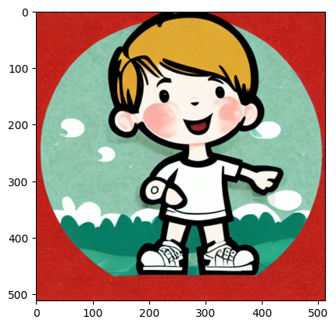
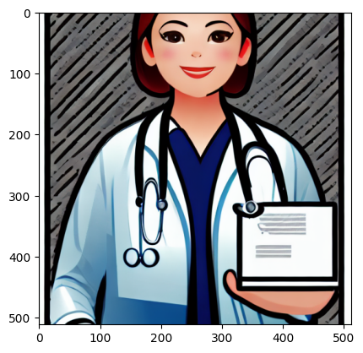
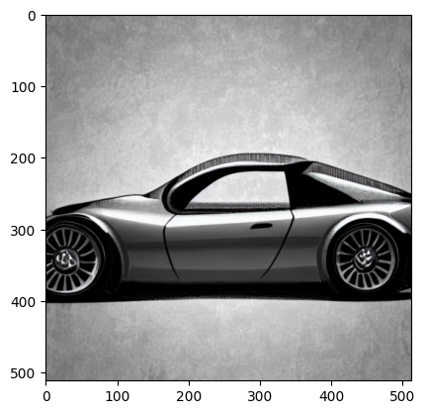
WITHOUT FT. TEXT
(image generation)
Notes:
Undesirable artefacts like the stetho

Slide 12
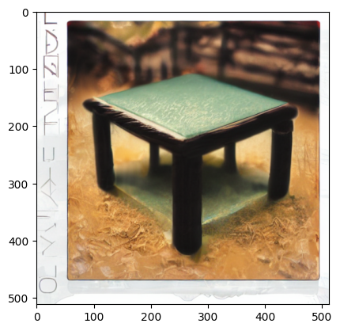
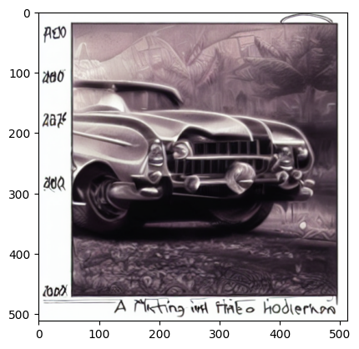
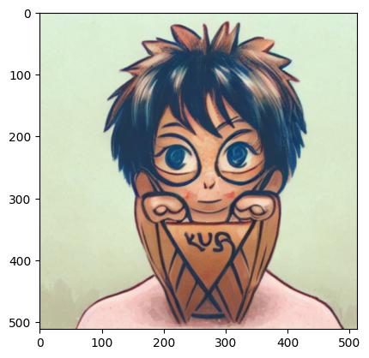
WITHOUT FT. TEXT
(style transfer)
Notes:
Undesirable artefacts like the stetho

Slide 13
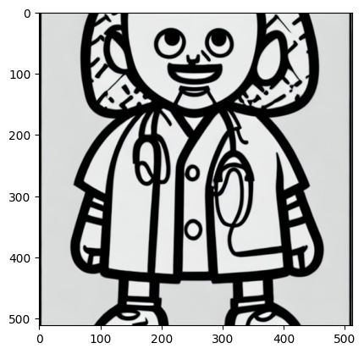
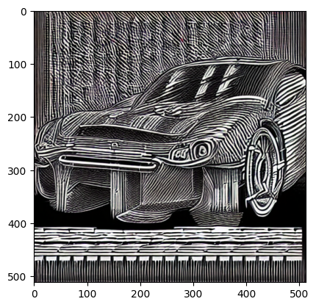
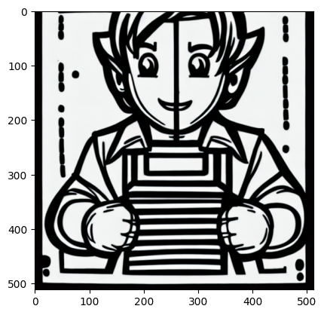
WITHOUT FT. UNET
(image generation)
Notes:
Undesirable artefacts like the stetho

Slide 14
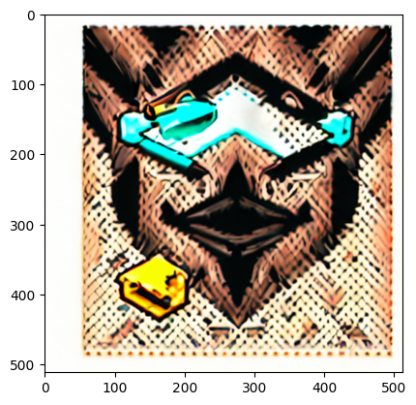
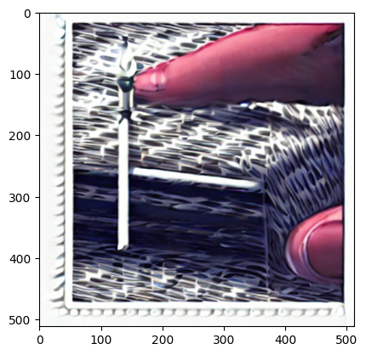
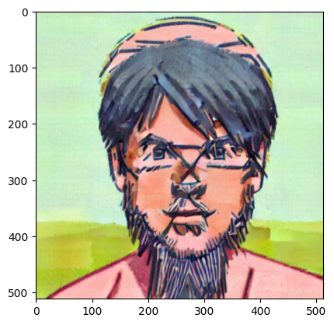
WITHOUT FT. UNET
(style transfer)
Notes:
Undesirable artefacts like the stetho

Slide 15


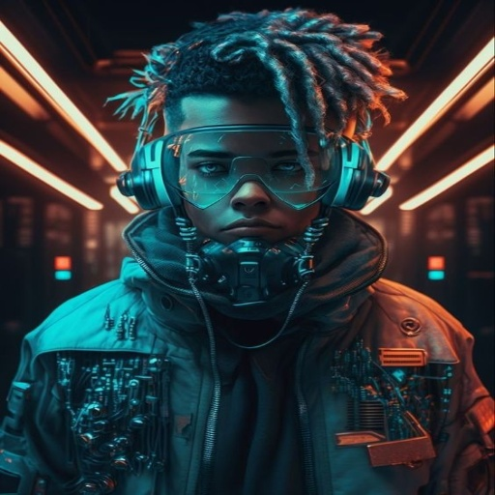

STYLE
CYBERPUNK

Slide 16
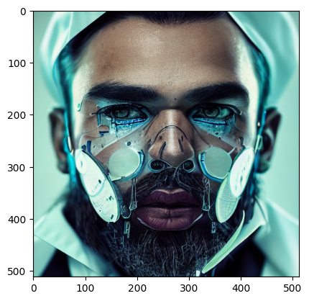
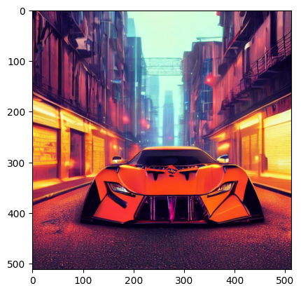
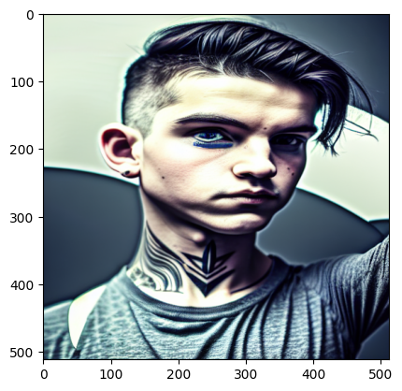
WITH FT. ALL
(image generation)
Notes:
Undesirable artefacts like the stetho

Slide 17
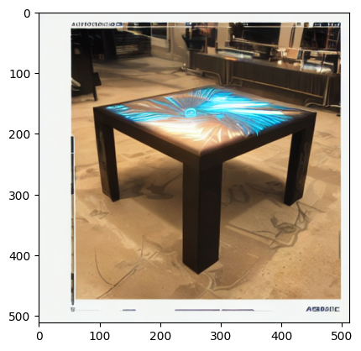
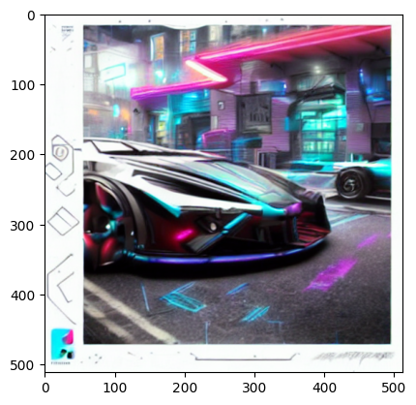
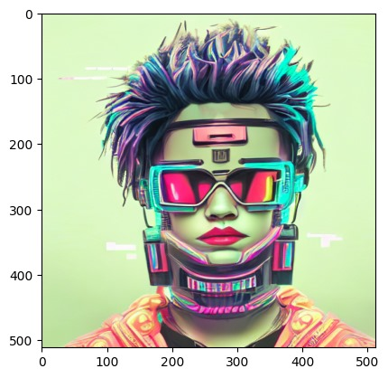
WITH FT. ALL
(style transfer)
Notes:
Undesirable artefacts like the stetho

Slide 18
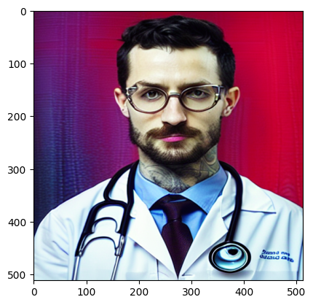
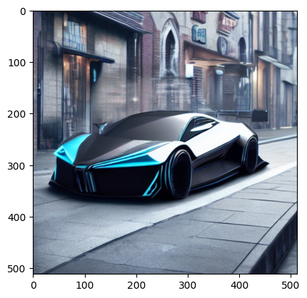
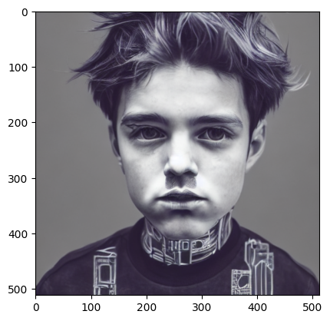
WITHOUT FT. VAE
(image generation)
Notes:
Undesirable artefacts like the stetho

Slide 19
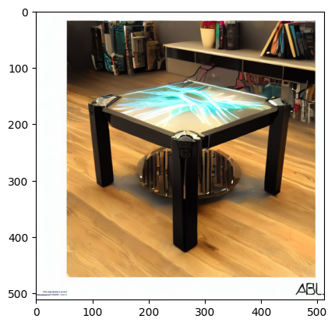
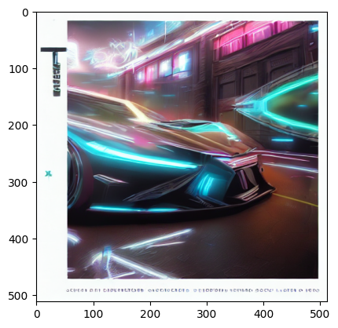
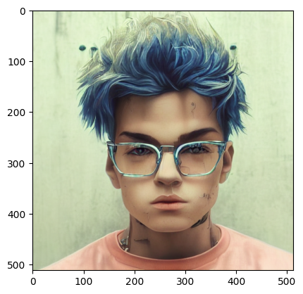
WITHOUT FT. VAE
(style transfer)
Notes:
Undesirable artefacts like the stetho

Slide 20
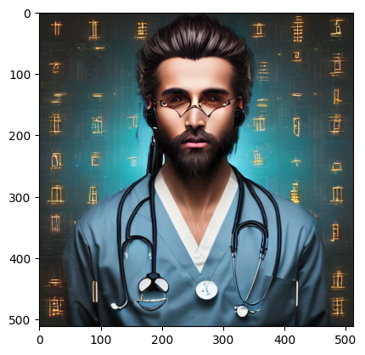
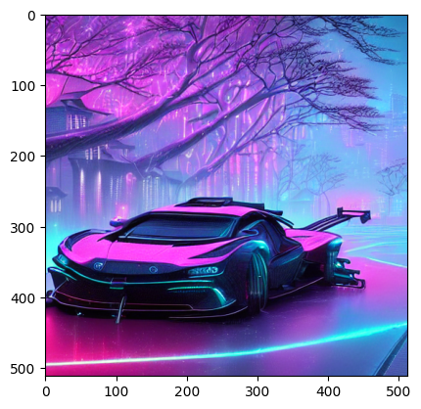
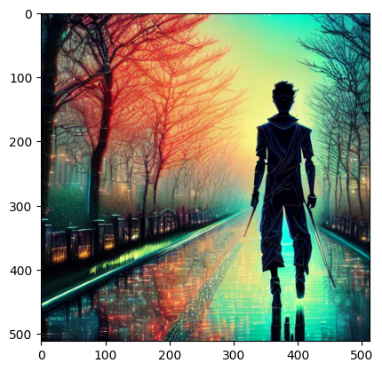
WITHOUT FT. UNET
(image generation)
Notes:
Undesirable artefacts like the stetho

Slide 21
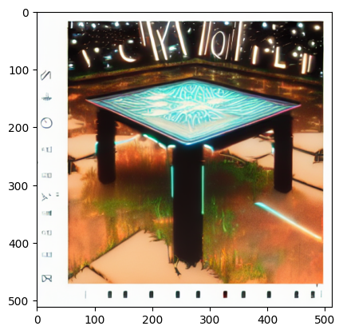
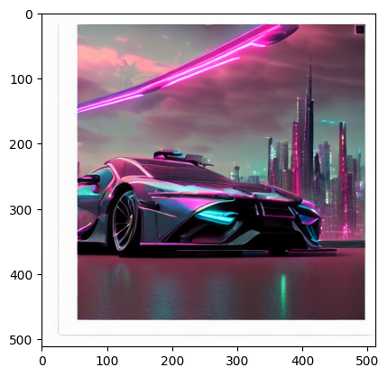
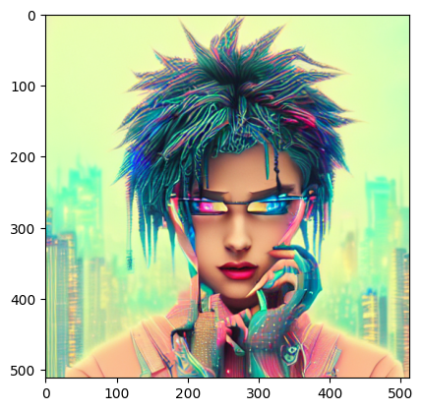
WITHOUT FT. UNET
(style transfer)
Notes:
Undesirable artefacts like the stetho

Slide 22
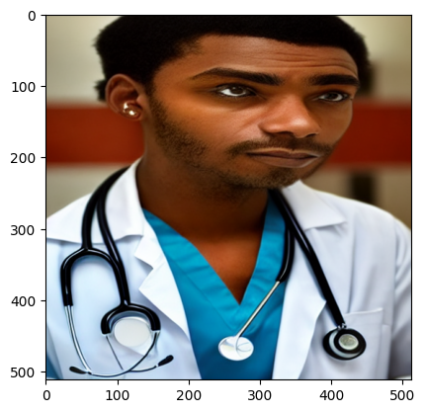
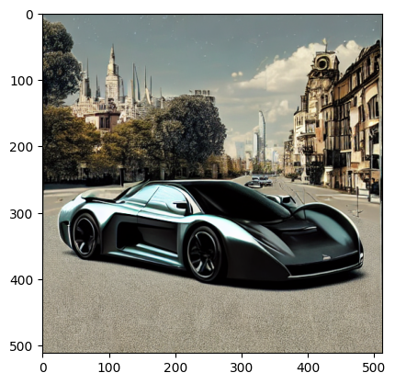

WITHOUT FT. TEXT
(image generation)
Notes:
Undesirable artefacts like the stetho

Slide 23



WITHOUT FT. TEXT
(style transfer)
Notes:
Undesirable artefacts like the stetho

Slide 24
Conclusions
Fine-tuning the text encoder plays a crucial role specially for the task of image generation but its effect is felt less for the task of style transfer from one image to another.
Fine-tuning the UNet plays the most crucial role for a consistent output for both the tasks.
Fine-tuning of the VAE is necessary for a cleaner and more stable output.

Slide 25

Thanks!
Arkadeep Acharya
2101A41
STABLE DIFFUSION 1.5
PROMPT: “STYLE TRANSFER”

